Slide 1
Storefront Testing App Architecture
CS 499 Group 4 “Bugs are Features Too”
Seanna Lea LoBue, Michael Murray, Eric Prewitt, Nicholas Wade, Kee West

Slide 2
Outline
Project Overview
High Level Design
Architecture Diagram
Design Pattern
Lower Level Design
Methods
User Interface
Testing
Summary
Questions

Slide 3
Project Overview
Customer: Ben Fox - Trissential
Trissential: Software Quality Assurance
Needs
Create a functioning ecommerce webstore
Toggle the addition of bugs to the store
Admin can control bugs on a per-user basis
Easy to update (add new bugs)
Why?
Practice Automated Testing Scripts in a controlled environment
Evaluate employees
Demonstrate services to prospective clients

Slide 4
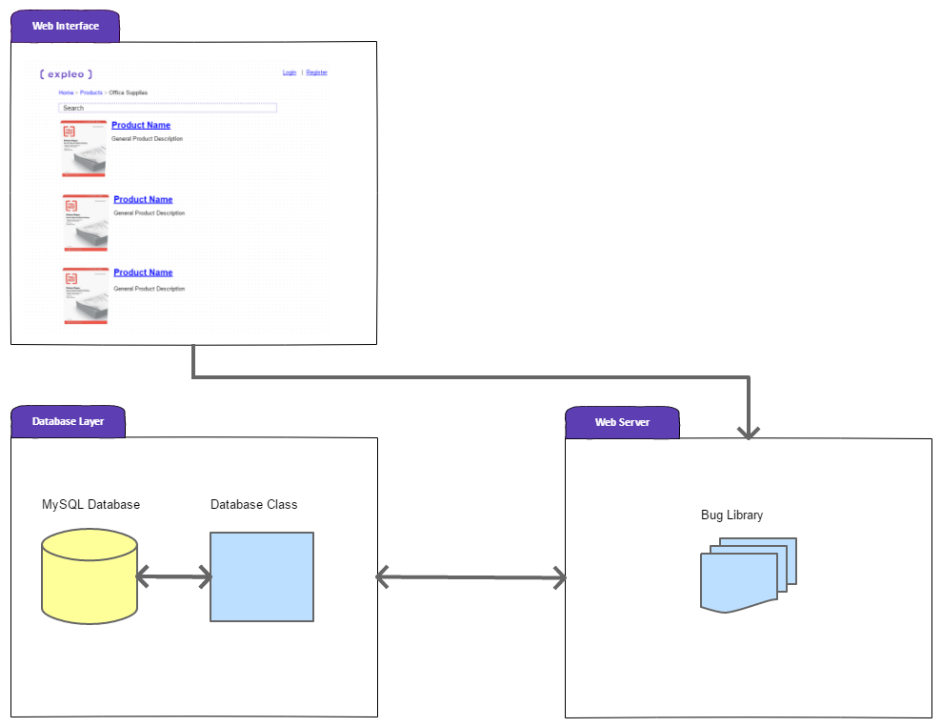
Architecture Diagram
Comprised of three components
Web Server with Bug Library
Storefront Web Content
Database Interface
Customer Requirements
mySQL
Apache - preferred over IIS
Either Windows or Linux

Slide 5
Design Pattern
Client-Server
Client
Interact with displayed content
Issue database queries
Admin - configure how clients interact with server
Server
Serve web page redirects
Serve database query results
Manipulate content served based on bug assignments

Slide 6
Methods - Webstore
Product Filter
Each filter selection connected to a partial query string
On selection change, read state of filters
Concatenate partial query strings
Send full query to database and retrieve results
Order history
On page load, check user login status
Query current user against order table
Render results in a easily parsable form.

Slide 7
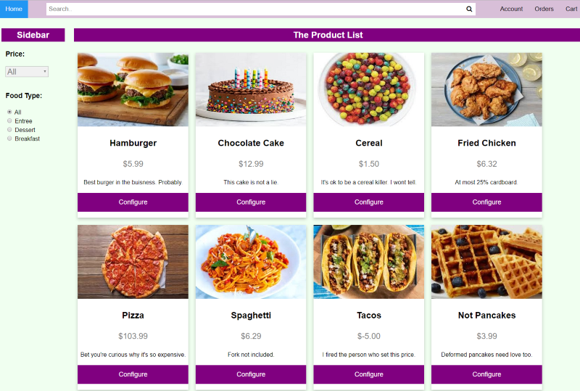
UI - Product List Page

Slide 8
Methods - Admin/Bugs
Admin
View results of all user query and all bug query
User pane allows administrator to select user
Bugs are selected by one or more of:
click and drag,
double click, or
arrow key
Bug Framework
Page interactions trigger database query
Interaction matched to determine if related to a bug
If bug, pages/methods loaded determined by user-bug relation

Slide 9
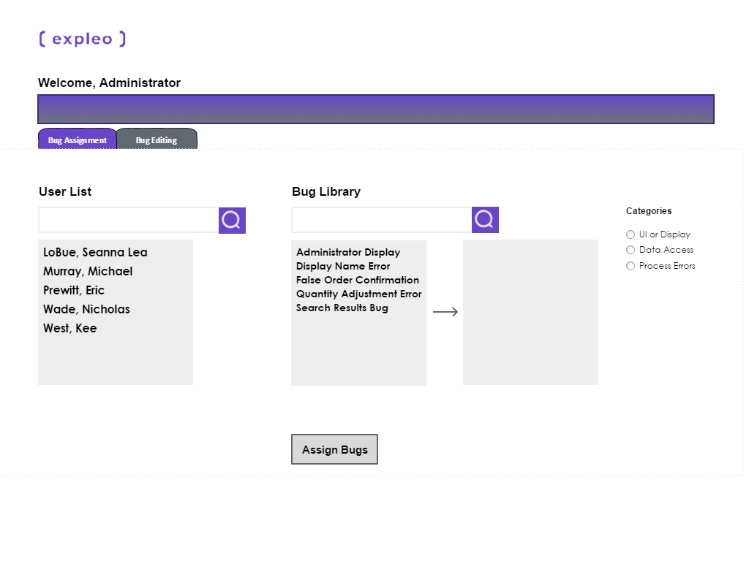
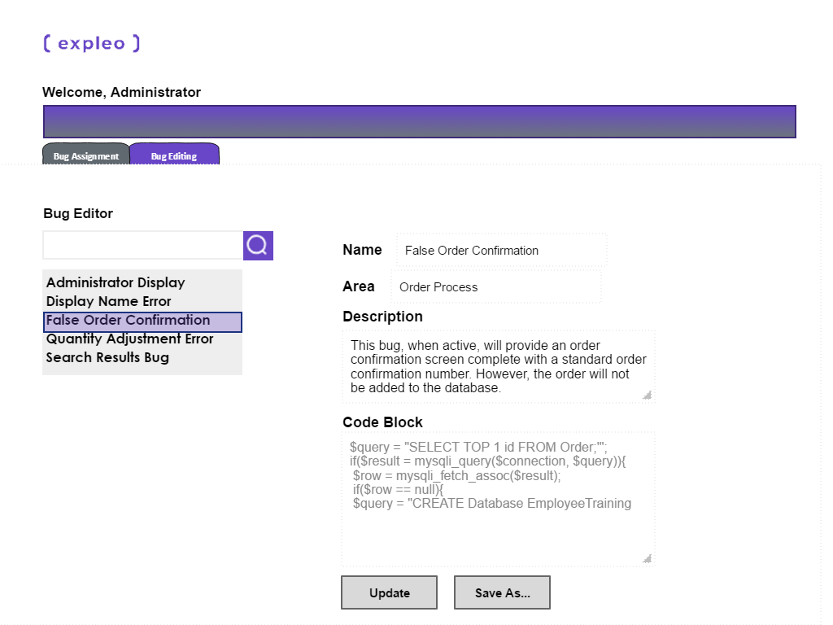
UI - Admin Page

Slide 10
Testing - Webstore
Mix of unit and integration tests
Testing done using Selenium
Objective | Test Description | Expected Result
Ensure product filters, function as intended. | Click on a product filter. | Items left on the page match expectation.
Objective | Test Description | Expected Result
Ensure placed order shows in order history. | Place an order. Click Orders button. | Redirects to order history page and order is present and correct.

Slide 11
Testing - Bug Framework
Relies on the baseline webstore
Objective | Test Description | Expected Result
Ensure Admin can set a bug for a user. | Admin sets a bug for a user. That user logs into their account. | User experiences the impact specific to the bug.
Ensure set bug only affects target user. | Admin sets a bug for User 1. User 2 logs into account. | User 2 does not experience the bug set for User 1.
Ensure new bugs can be added. | A bug is added to the database. This bug is set to active. | The new bug has the intended impact.

Slide 12
Summary
Designing a system to toggle occurance of bugs
Web server coordinates:
User interfaces
Bugs
Element Database
Functional and Visual Design
Webstore
Bug Administration
Testing
Individual pages and page interactions
Bug deployment

Slide 13

Questions?
Thanks for your attention.

